Slide 1
DanceSoft
Senior design group: Marcus Berger and Dicheng WU

Slide 2


Rapid City Academy of Dance Arts
What is the Academy of Dance Arts
Dance school with located in Rapid City, South Dakota
Provide dance classes for student in the area
Sponsor: Dr. Jeff McGough, Vice president
Main Client: Julie McFarland, Owner and Artistic Director

Slide 3
Project Overview
Purpose of project / Goal
Developing a software for administers and teachers and students in Academy of Dance arts to manage the day-to-day activities.
Project Needs
Database needs to store administers and teachers and students and classes information, it also needs to be accessed by different permission levels.
GUI needs to be as intuitive as possible to use and it should display administers and teachers and students and classes information when user request it.
Development Constraints
Project must be open source.
Clients primarily run Mac so the project must work in this environment.
Wi-Fi/bandwidth issues for the academy
Project functionality
Administers can see the information for every teacher and student.
Teachers can see his or her student’s information and classes schedules.
Students can see classes schedules and register for classes.

Slide 4
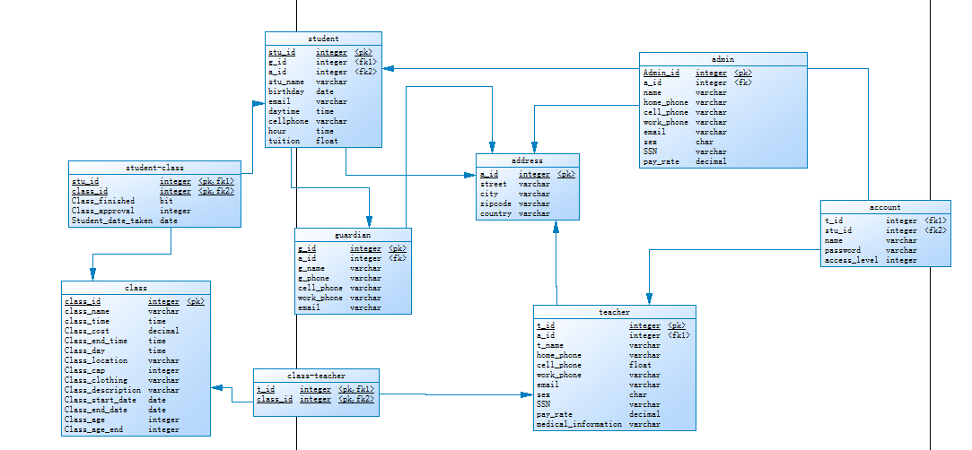
Database Architecture

Slide 5
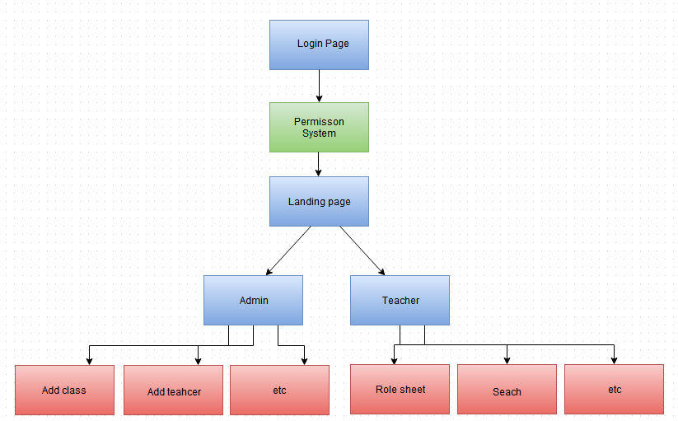
GUI Architecture

Slide 6
User Stories
User Stories worked on since sprint 1:
Admin User Stories
As the owner I would like to indicate clothing requirements per class.
Modify employee and student information
Adding information to the system
Teacher User Stories
As a teacher I would like to get a class role for each class
As an employee I would like to be able to look up student data
As an employee I would like to be able to add/remove students from a class

Slide 7
Backlog Since Sprint 1
Write database creation script
Determine needed GUI pages and path
Create the log in page with permission levels
Landing pages for admin and teacher
Create various update pages
Create search pages for students, and employees
Add information functions (new class, new teacher etc.)
Class role sheet and assign teacher to class

Slide 8
Remaining Backlog
Research box and server possibilities
Student interface and functions
Register
Sign up for classes
Payroll and Billing Interface
Track hours
Calculate pay
Tuition functions
Clean up GUI

Slide 9
Current Testing Procedure
Some interior code testing like Sql Query within code
Most testing for the project in its current form is manual GUI testing
Taking a page testing functionality and looking at the database result or modification needs.
Most test were database interactions and then checking for correct results.
When the project reaches a more connected state, should be possible to write execution test to test expected functionality within GUI without requiring as much developer input.
Future Sprint Testing:
Payroll and billing calculation
Student interface interactions
Multiple instance testing

Slide 10
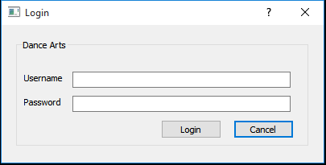
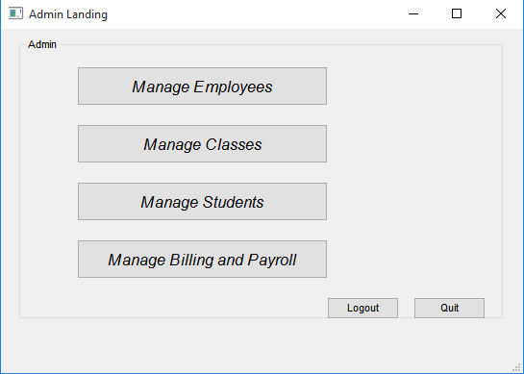
Prototype: Starting Pages
Team worked on several project functionalities that function independently at the present time
Pages Worked on:
Log in: Landing Pages:

Slide 11
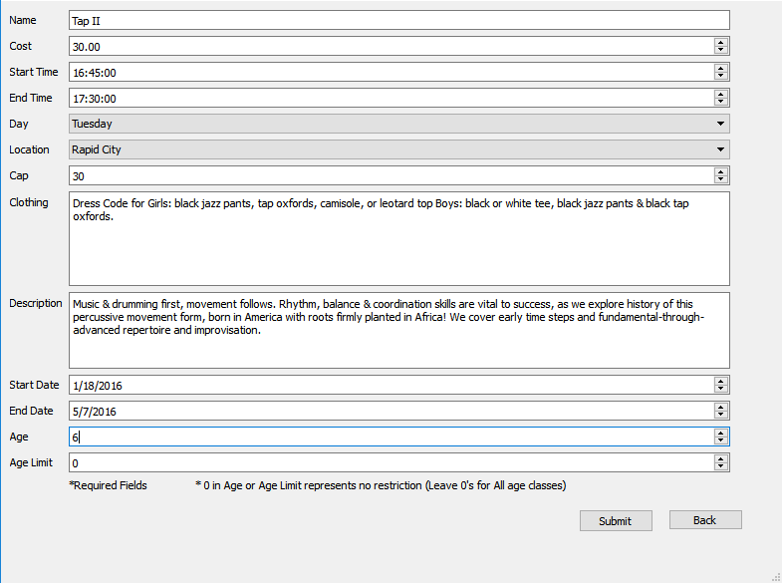
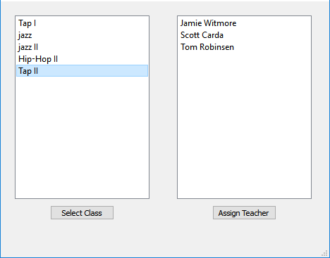
Prototype: Add and Assign
Add a Class Assign Teacher to Class:

Slide 12
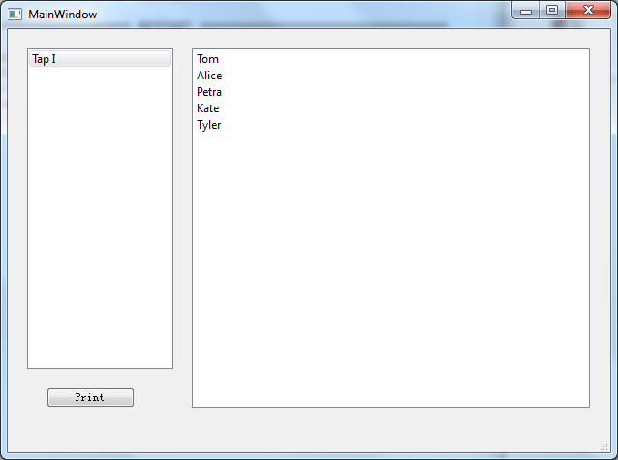
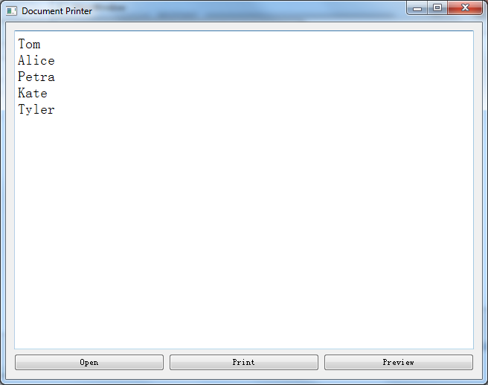
Prototype: Role
Role Sheet

Slide 13
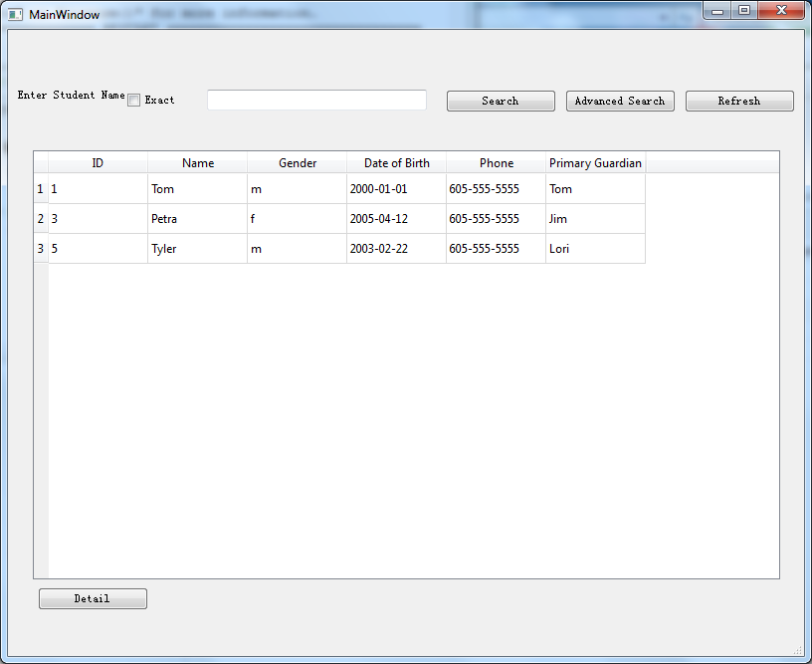
Prototype: Search
Search Pages

Slide 14
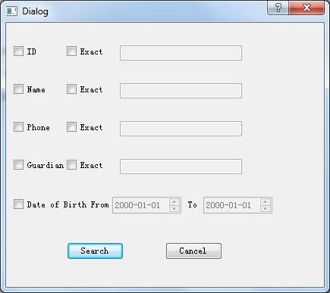
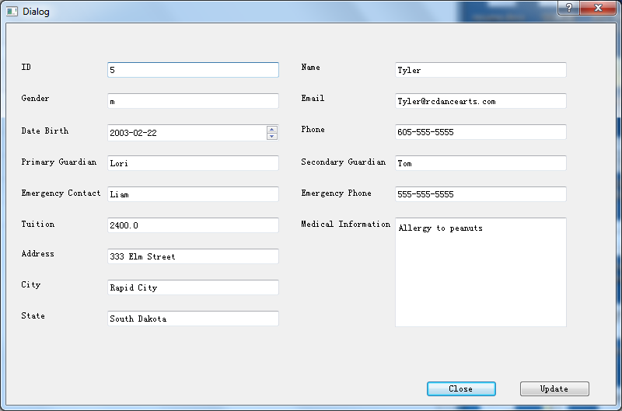

Slide 15
Project Update
Updates since sprint 1:
Mysql database creation
Log in page
Landing pages
Add and update information forms
Search pages
Class role
Assign teacher to a class and modify students in a class

Slide 16
Tool and Budget Update
Tools:
Xcode and Visual Studio
Github and Trello
Pyqt
Mysql
No budget currently - Box budget not currently decided
Intellectual Property: All open source, no licensing issues

Slide 17
Successes and Failures
Successes:
Completed all assigned functionality on time
Team worked effectively together overall
Failures:
Small dialog bug in assign class page currently
Never really got ahead on sprints
Team let other obligations interfere with team efficiency at times outside of meetings
Were unable to tie individual functions together before end of semester (will be addressed during winter break)

Slide 18
Risk and Mitigation
Usability:
Continue to keep interfaces as simple as possible for user, while not compromising the wanted functionality
Retrieval of information and easy to use
Data backup
Backup database in local machine and Linux box.
Security
Encryption of the data
Protect user data

Slide 19
Future Sprints
Winter Break(12/16/15 -1/11/16) – First semester clean up, student interface, Tie functions together
Sprint 4 (1/18/16 - 2/5/16) – billing and payroll, testing
Sprint 5 (2/15/16 - 3/4/16) – work on remaining GUI backlog or student interface, testing
Final Sprint (3/21/16 - 4/15/16) – Clean up GUI work, Final Testing, Final production, Design fair preparation

Slide 20
Final Review and Deliverables
Sprint 2: Database creation, GUI path, Log in screen, Landing pages
Sprint 3: Search pages, Update pages, Add information pages, Role sheet
Sprint reviews and Client presentation

Slide 21
Any Questions?

